Slide 1
NLP Course – 097215
Winter 2021-2022
Tomer Volk

Slide 2
Contact information
tomervolk13@gmail.com
tomervolk@campus.technion.ac.il
Office Hours:

Slide 3
Grade
2 wet assignments (code) – 15% each
2 dry assignments (theory) – 5% each
Final Project – 60%

Slide 4
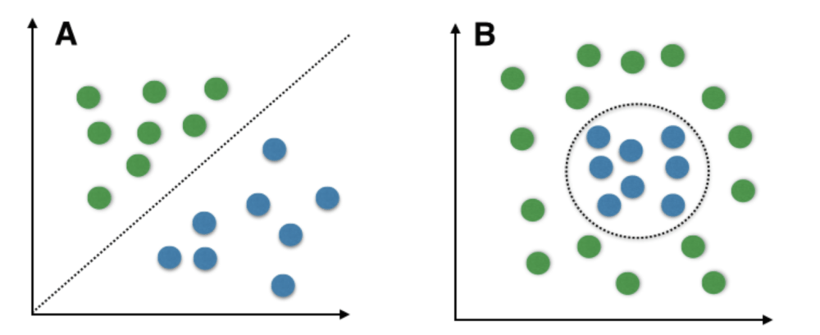
Classifier
Positive vs. negative reviews
Spam vs. not spam
Part of speech tagging
Named entity recognition

Slide 5
Tf-IDF
TF – term frequency
The number of appearances in this document
IDF – inverted term frequency
If a word appears in many documents, the score will be lower

